Slide 1


Advanced T-SQL Pattern Matching: Leveraging LIKE and Regular Expressions

Slide 4

SQL Clinic
Get your SQL questions answered here by our SQL experts during our breaks!
(Across from Registration)

Slide 5

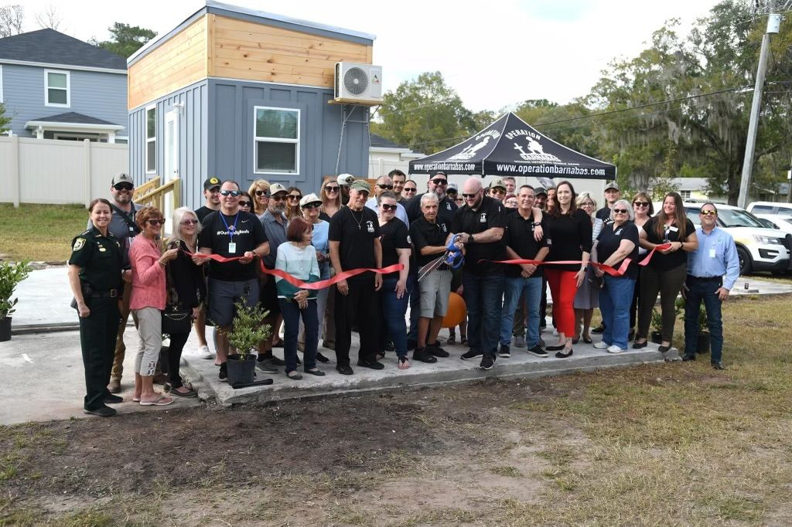
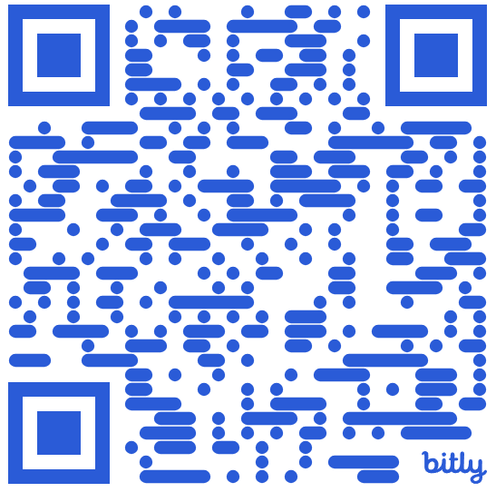
501 Legion Charitable Donation For Housing
Thank the 501 Legion for Supporting Our Event!
JSSUG Will Match Donations up to $500
Donation Bucket on Registration Table
Our vision for Ft. Barnabas is to one day be a bastion of hope and stability in guiding veterans on their path to stability. Fort Barnabas will be constructed as a mixture of portable tiny homes, or “Barnabas Bungalows,” and brick-and-mortar condo-style family homes. https://operationbarnabas.com/get-involved/

Slide 6
Session Evaluations
Your feedback is important to us!
Please fill out and hand to speaker after the session!

Slide 7
Event Evaluation
Fill out event evaluation card in your bag and visit all sponsors to be entered to win an Xbox Series X – (Must be present to win)

Slide 8
Register now!
See you in Seattle!
Get $150 off a 3-day ticket!
Use code: SQLSATJACKS150
passdatacommunitysummit.com

